Slide 1
ASP.NET MVC

Slide 2
ASP.NET Web Applications
PageModel
Code File
http Request
Browser
http Response
cshtml

Slide 3
ASP.NET MVC Web Applications
Browser
Controller
View1
View2
View3
cshtml
cshtml
cshtml

Slide 4
Architecture
The Model-View-Controller (MVC) architectural pattern separates an application into three main components:
The model,
The view, and
The controller.

Slide 5
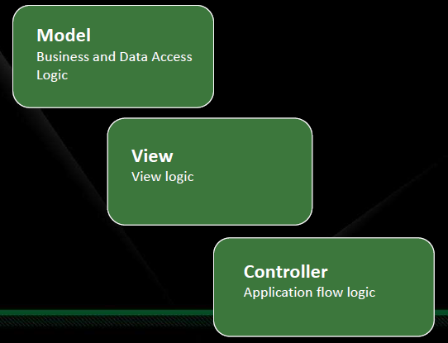

Slide 6
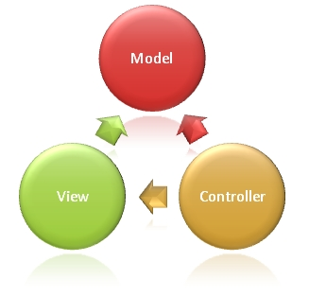
http Response
http Request

Slide 7
Model :
Model objects are the parts of the application that implement the logic for the application’s data domain. Often, model objects retrieve and store model state in a database.
Views.
Views are the components that display the application’s user interface (UI). Typically, this UI is created from the model data
Controllers.
Controllers are the components that handle user interaction, work with the model, and ultimately select a view to render that displays UI.

Slide 8
In an MVC application:
1. The view only displays information;
2. The controller handles and responds to user input and interaction. The controller handles query-string values, and passes these values to the model,
3. The model queries the database by using the values.

Slide 9
ASP.NET MVC
Browser
Web Application
View Controller
cshtml
cshtml
cshtml

Slide 10
ASP.NET MVC
Browser
Web Application
<<model>>
Business Controller
<<model>>
View Controller
<<model>>
RDBMS
<<model>>
<<model>>
EF
ORM
cshtml
cshtml
cshtml

